Slide 1
NoSQL Exploration
Junai Abbasi
Nikhil Mungel
Vaishak Suresh

Slide 2
MongoDB
Mongo as in HuMongous.
We used Github Events to explore MongoDB’s capabilities.
Downloaded all events for 2012 (~55GB)
Data too big for laptops, so used 1 month’s data (~5 GB)

Slide 3
Github Events
No direct way to download, GitHub only provides an API, that is rate-limited.
Used GithubArchive.org to get old data.
Events we focused on:
PushEvent
WatchEvent
IssueEvent
FollowEvent

Slide 4
Storage
Github_events was the db we used.
Each event was a separate collection ex: watch_events, push_events
Data already in JSON format – Minimal processing.

Slide 5
Some interesting queries
Top repositories
Top users
Repositories with most issues
Most watched repositories

Slide 6
Lessons learnt and problems faced
Unicode characters were not properly encoded.
Since each event was unique, MongoDB’s ‘_id’ was good enough.
Grouping does not work with large data (>1000), Aggregation is the alternative.
Sharding on the same machine is not very helpful

Slide 7
MongoDB - Demo

Slide 8
Neo4j
Leading persistent graph store (OSS)
Nodes and Relationships
Indexes
ReSTful API
Runs on JVM (written in Java)

Slide 9
Github
Leading social coding platform.
Events published for all public user actions.
No “people you may be interested in” feature.

Slide 10
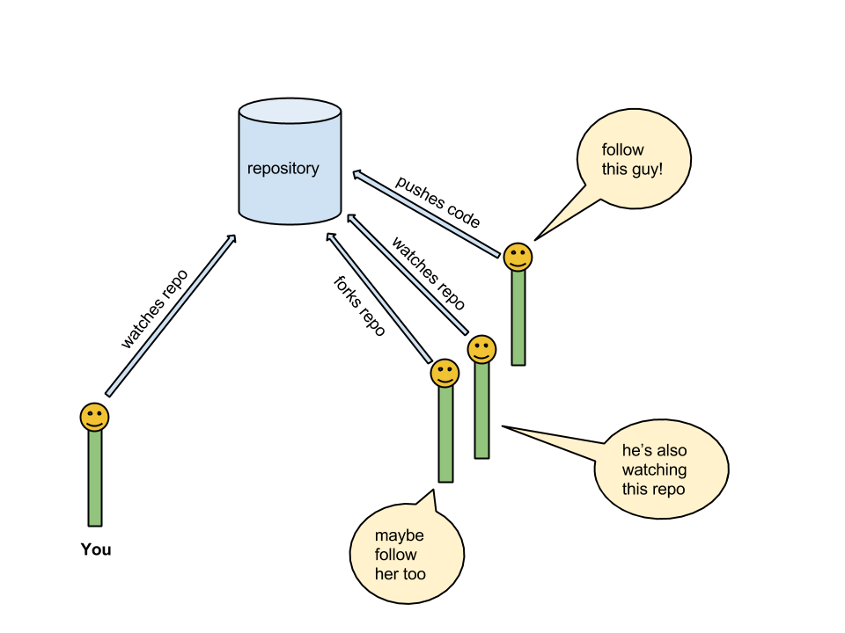

Slide 11
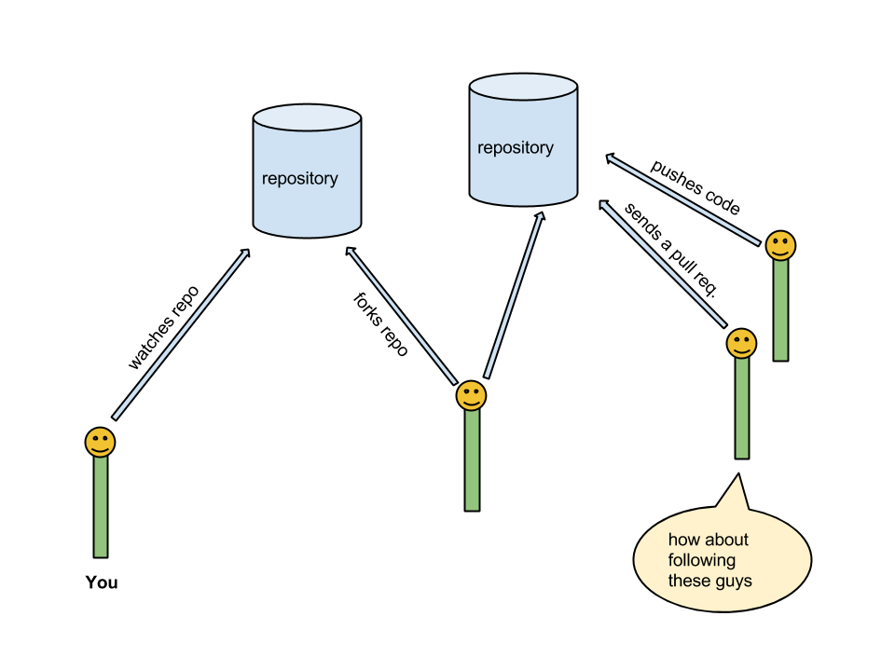

Slide 12
GitHub Top Ten repositories
Analyzed full one year data to find open and closed issues
Data Set Publishing Language (DSPL) format used for generating graphs on google.com
http://www.google.com/publicdata/directory
Here are the findings:

Slide 13
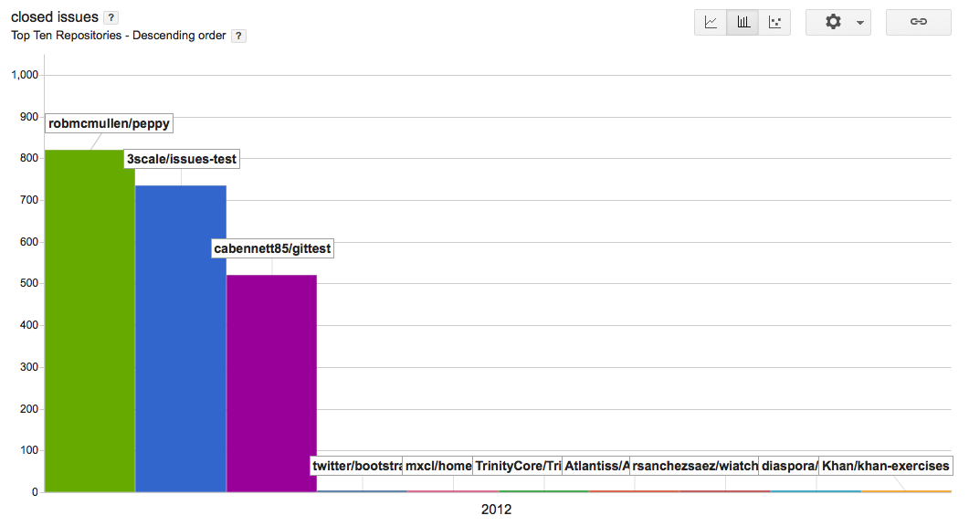
Closed Issues

Slide 14
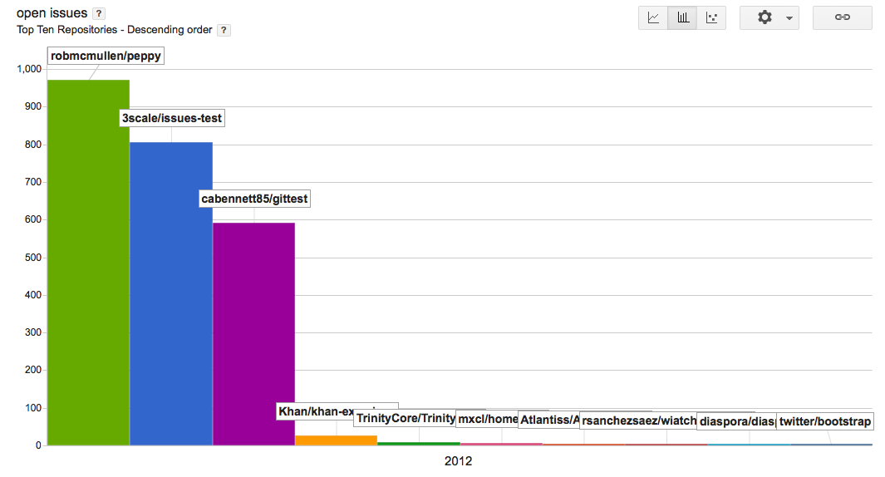
Open Issues

Slide 15
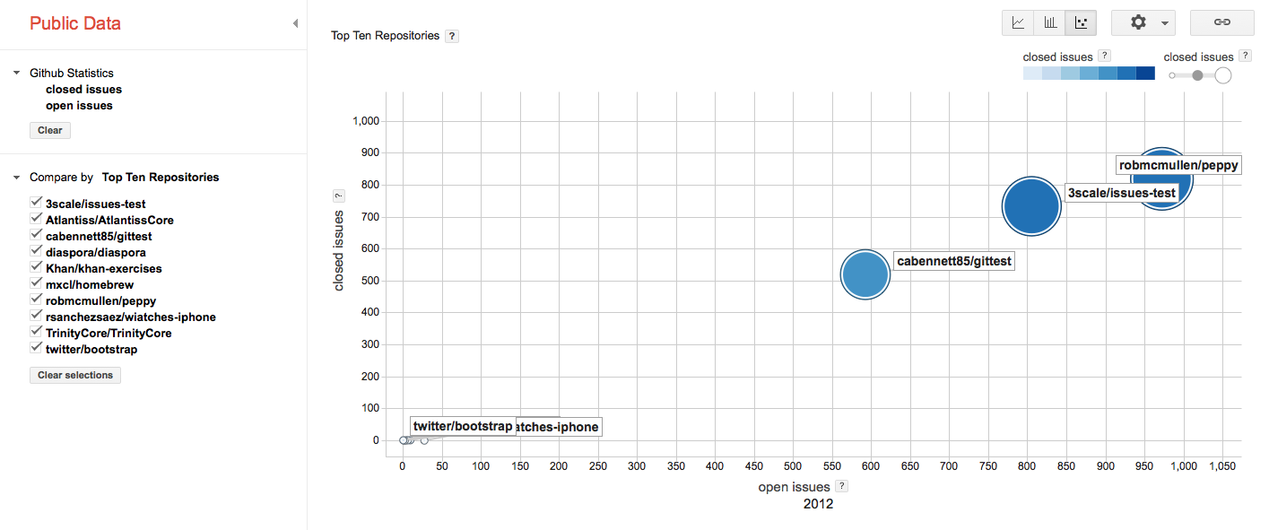
Open Closed Issues

